Slide 1
Data Communications

Slide 2
Hamming Code
.

Slide 3
Hamming Code
To Detect 2 bit error
To correct 1 bit error
.

Slide 4

Hamming Code
Number of redundant bits
.

Slide 5
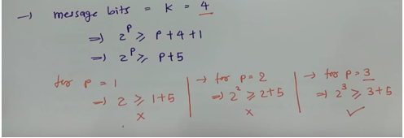
Hamming Code
Number of redundant bits
.

Slide 6
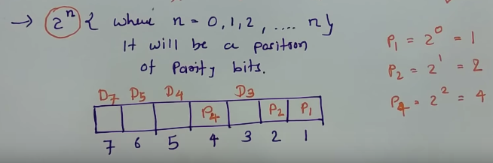
ERROR CORRECTION
Position of redundant bits
.

Slide 7
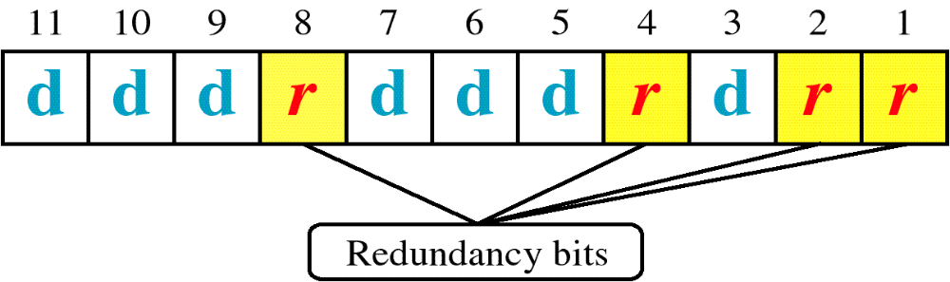
Hamming Code
.

Slide 8
Hamming Code
Find the additional bits required to send the following bits:
1001101
.

Slide 9
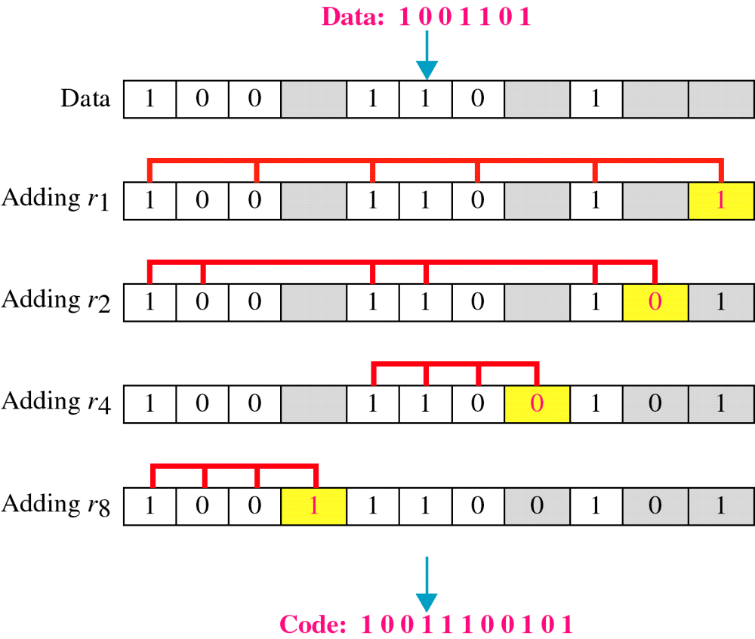
Hamming Code
.

Slide 10
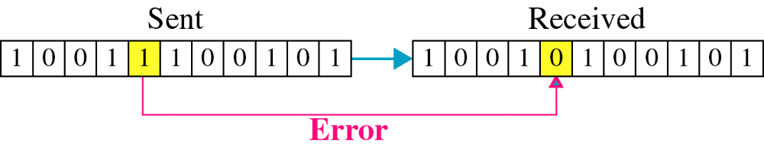
Hamming Code
Single-bit error
.

Slide 11

Hamming Code
Error
Detection
.

Slide 12
.

